Slide 1
Topic Modeling

Slide 2
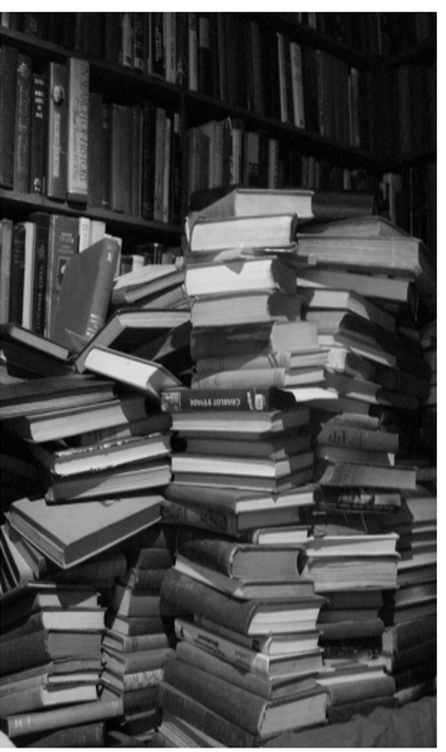
Topic modelling provides methods for automatically organizing, understanding, search, and summarizing large electronic archives:
1. Discover the hidden themes in the collection
2. Annotate the documents according to these themes
3. Use annotations to organize, summarize, search, and form predictions

Slide 3
Many Applications of Topic Modeling

Slide 4
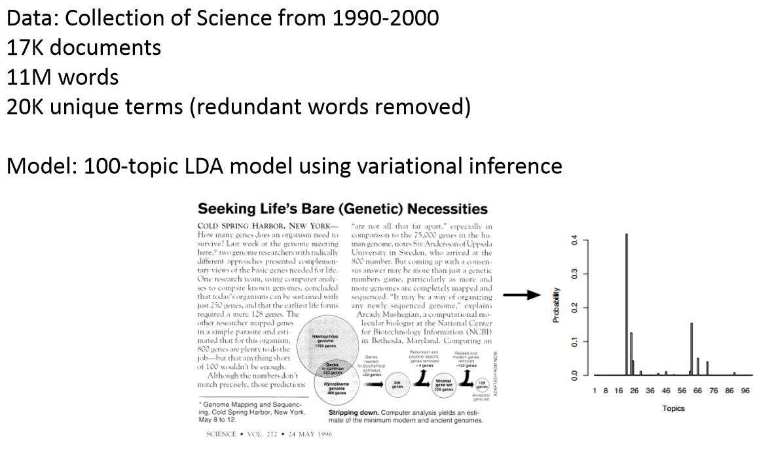

Slide 5
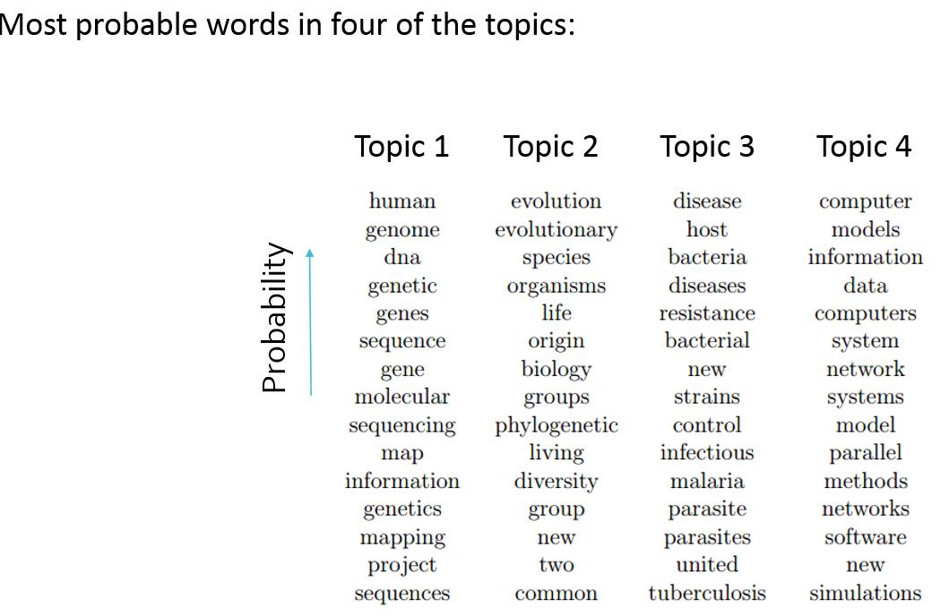

Slide 6
Supercar Racing Fans’ Tweets
"rt @redbullracingau: the wait is almost over! here's a little 2014 #clipsal500 preview to whet your #v8sc-starved appetites http://t.co/boeÃ¢â‚¬Â¦"
"rt @dunlopseries: walsh lands first blow in dunlop series practice: ash walsh has topped both opening sessions at the clip... http://t.co/uÃ¢â‚¬Â¦"
"rt @harfserious: "just give me a sec, turn 8 is bloody crazy" love that comment as @smclaughlin93 takes u for a lap #v8sc http://t.co/blrl5Ã¢â‚¬Â¦"
"rt @smclaughlin93: amazing day! thanks so much for the support everyone, my @grmotorsport boys are the best! thanks @volvocarsaus and @poleÃ¢â‚¬Â¦"
"surprised to see the volvo do so well in #v8sc quali. the adelaide street race is one of my favourite rounds."
"rt @v8supercars: mclaughlin: we can win!: front row qualifying only the start for volvo says young gun.&gt; http://t.co/mzkljhjzzj #v8sc"
"rt @daveyk7: a pattern has been formed in 2014 already.... go get 'em @craiglowndes888 #clipsal500 #v8sc @redbullracingau http://t.co/eu7inÃ¢â‚¬Â¦"
"looking forward to seeing how today's #v8sc races play out. as they say, the bullshit stops when the flag drops!"
"@markberetta hope the sun keeps shining today! let the racing begin!! #sptools #v8sc #clipsal500"
"rt @v8supercars: mclaughlin: we can win!: front row qualifying only the start for volvo says young gun.&gt; http://t.co/mzkljhjzzj #v8sc"

Slide 7
Topic Modelling
Supervised
Require manually labelling a training dataset with a pre-defined list of topics
Unsupervised
No manual labels required
Unsupervised vs. supervised

Slide 8
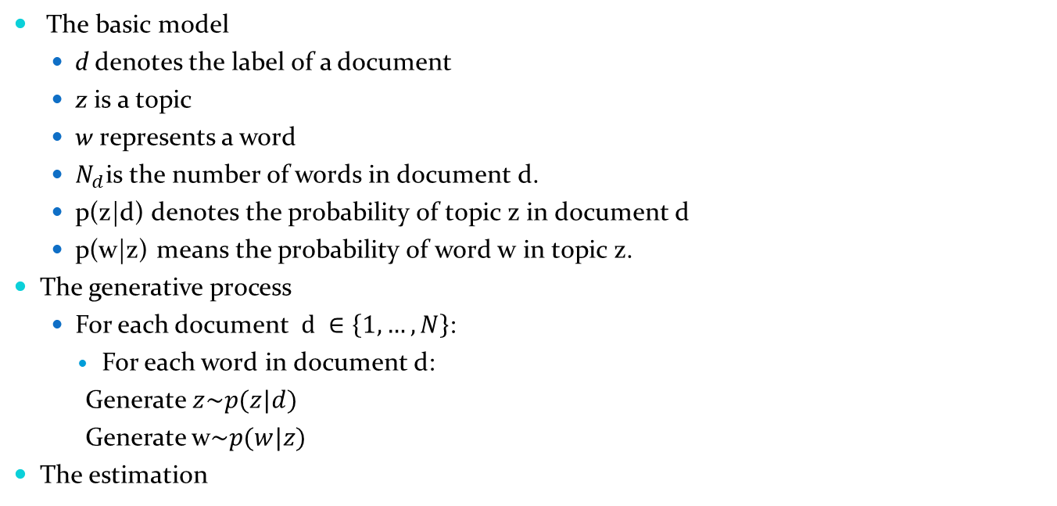
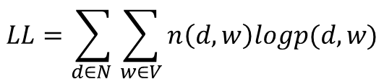
Probabilistic Latent Semantic Analysis(PLSA)
The basic model
d denotes the label of a document
z is a topic
w represents a word
$N_{d}$is the number of words in document d.
p(z|d) denotes the probability of topic z in document d
p(w|z) means the probability of word w in topic z.
The generative process
For each document $d ∈\left\{1,…,N\right\}$:
For each word in document d:
Generate $z\sim p(z|d)$
Generate w$\sim p(w|z)$
The estimation
$$LL=\sum_{d∈N }{\sum_{w∈V}{n\left(d,w\right)logp(d,w)}}$$

Slide 9
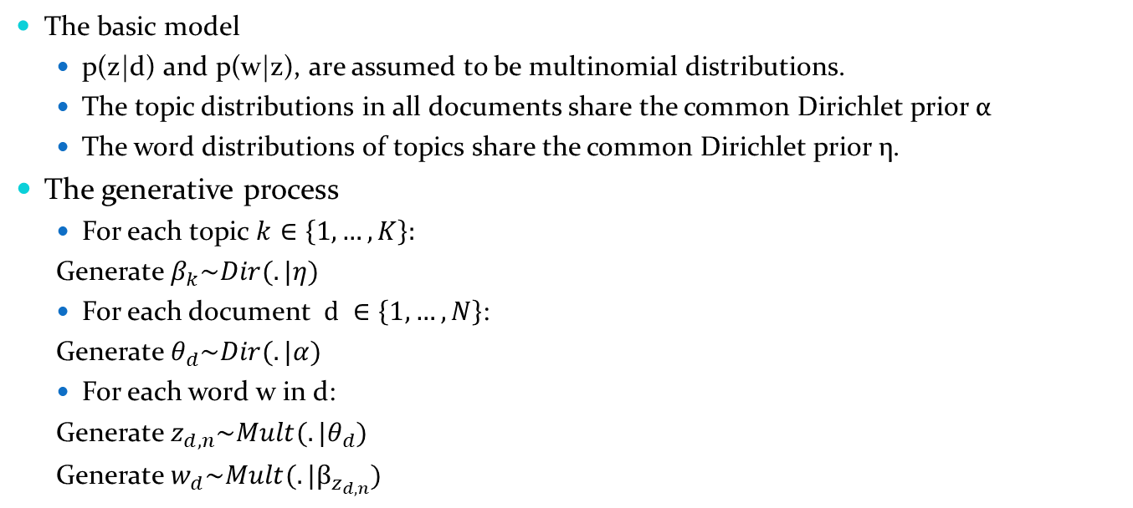
Latent Dirichlet Allocation (LDA)
The basic model
p(z|d) and p(w|z), are assumed to be multinomial distributions.
The topic distributions in all documents share the common Dirichlet prior α
The word distributions of topics share the common Dirichlet prior η.
The generative process
For each topic $k∈\left\{1,…,K\right\}:$
Generate $β_{k}\sim Dir(.|η)$
For each document $d ∈\left\{1,…,N\right\}$:
Generate $θ_{d}\sim Dir(.|α)$
For each word w in d:
Generate $z_{d,n}\sim Mult(.|θ_{d})$
Generate $w_{d}\sim Mult(.|β_{z_{d,n}})$

Slide 10
Per-corpus
topic distribution
Topic 1
love .5
like .25
feeling .15
miss .1
Topic 2
book .4
university .3
professor .2
love .1
Topic T
…
…
Per-word
topic assignment
Per-document topic proportion
Doc 1
Jenny loves Jack. But Jack does not love Jenny.
Doc 2
Jenny enjoys reading books. Her parents are professors.
Doc D
…
…
..

Slide 11

Per-corpus
topic distribution
Per-document topic proportion
Per-word
topic assignment
$$p\left(β,θ,z,w\right)=(\prod_{k=1}^{K}{p(β_{k}|η})(\prod_{d=1}^{N}{p(θ_{d}|α)\prod_{n=1}^{N_{d}}{p\left(z_{d,n} | θ_{d}\right)p(w_{d}|z_{d,n},β_{k})}}$$

Slide 12
Run Topic Modelling (LDA)
Topic modelling packakages: Sklearn, Gensim, Mallet
Run TM using Sklearn
from sklearn.decomposition import LatentDirichletAllocation
from sklearn.feature_extraction.text import CountVectorizer
NUM_TOPICS = 10
vectorizer = CountVectorizer(min_df=5, max_df=0.9,
stop_words='english', lowercase=True,
token_pattern='[a-zA-Z\-][a-zA-Z\-]{2,}')
data_vectorized = vectorizer.fit_transform(data)
# Build a Latent Dirichlet Allocation Model
lda_model = LatentDirichletAllocation(n_components=NUM_TOPICS, max_iter=10, learning_method='online')
lda_Z = lda_model.fit_transform(data_vectorized)

Slide 13
Run Topic Modelling (LDA)
text = "mclaughlin: we can win front row qualifying only the start for volvo says young gun"
x = lda_model.transform(vectorizer.transform([text]))[0]
print(x, x.sum())
"mclaughlin: we can win front row qualifying only the start for volvo says young gun"
[0.11016597 0.01 0.25335035 0.01000684 0.01000061 0.01
0.01 0.01000217 0.2664824 0.30999166] 1.0

Slide 14
Car Racing Tweets
 | topic1 | topic2 | topic3 | topic4 | topic5 | topic6 | topic7 | topic8 | topic9 | topic10
0 | 0.033333 | 0.366668 | 0.033333 | 0.033333 | 0.033333 | 0.033333 | 0.033333 | 0.366665 | 0.033333 | 0.033333
1 | 0.011111 | 0.011111 | 0.011111 | 0.126793 | 0.011111 | 0.011112 | 0.673206 | 0.011111 | 0.122222 | 0.011111
2 | 0.009091 | 0.009091 | 0.009091 | 0.009091 | 0.918182 | 0.009091 | 0.009091 | 0.009091 | 0.009091 | 0.009091
3 | 0.009091 | 0.009091 | 0.009091 | 0.009091 | 0.918182 | 0.009091 | 0.009091 | 0.009091 | 0.009091 | 0.009091
4 | 0.010000 | 0.010000 | 0.010000 | 0.010000 | 0.910000 | 0.010000 | 0.010000 | 0.010000 | 0.010000 | 0.010000
... | ... | ... | ... | ... | ... | ... | ... | ... | ... | ...
12484 | 0.190910 | 0.463638 | 0.099999 | 0.099999 | 0.009091 | 0.009091 | 0.009091 | 0.100000 | 0.009091 | 0.009091
12485 | 0.190910 | 0.463638 | 0.099999 | 0.099999 | 0.009091 | 0.009091 | 0.009091 | 0.100000 | 0.009091 | 0.009091
12486 | 0.050000 | 0.050000 | 0.050000 | 0.050000 | 0.050000 | 0.050000 | 0.050000 | 0.550000 | 0.050000 | 0.050000
12487 | 0.014286 | 0.014286 | 0.442857 | 0.014286 | 0.157143 | 0.014286 | 0.157143 | 0.014286 | 0.157143 | 0.014286
12488 | 0.366670 | 0.033333 | 0.033333 | 0.366664 | 0.033333 | 0.033333 | 0.033333 | 0.033333 | 0.033333 | 0.033333

Slide 15
Keywords for Each Topic
def print_topics(model, vectorizer, top_n=10):
for idx, topic in enumerate(model.components_):
print("Topic %d:" % (idx))
print([(vectorizer.get_feature_names()[i], topic[i])
for i in topic.argsort()[:-top_n - 1:-1]])
print("LDA Model:")
print_topics(lda_model, vectorizer)

Slide 16
Keywords for Each Topic
LDA Model:
Topic 8:
[('mostert', 1161.4196466266721), ('whincup', 952.8878420998199), ('chaz', 799.4886817084397), ('supercars', 763.6402515747167), ('morris', 607.0090558537631), ('paul', 531.4341733355051), ('lap', 500.1492613036391), ('lowndes', 382.0937104460661), ('win', 378.5400174486639), ('mountain', 361.8081882987038)]
Topic 4:
[('race', 842.5132290367297), ('great', 368.19889428142824), ('sport', 244.25076715580823), ('best', 216.85719741412146), ('year', 187.72653487421601), ('team', 170.12016778716784), ('seen', 152.6338624795436), ('time', 151.08421068533525), ('weekend', 124.49014060194958), ('supercars', 123.19683837667617)]

Slide 17
Topic Modelling Map
#pip install PyLDAVis
import pyLDAvis.sklearn
pyLDAvis.enable_notebook()
panel = pyLDAvis.sklearn.prepare(lda_model, data_vectorized, vectorizer, mds='tsne')
panel

Slide 18
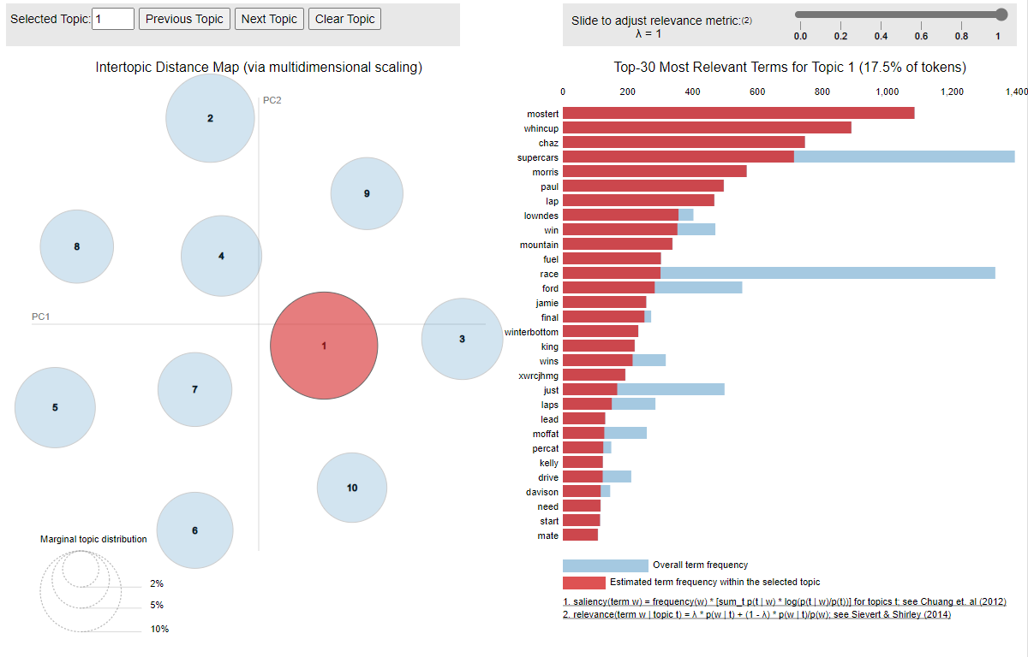

Slide 19
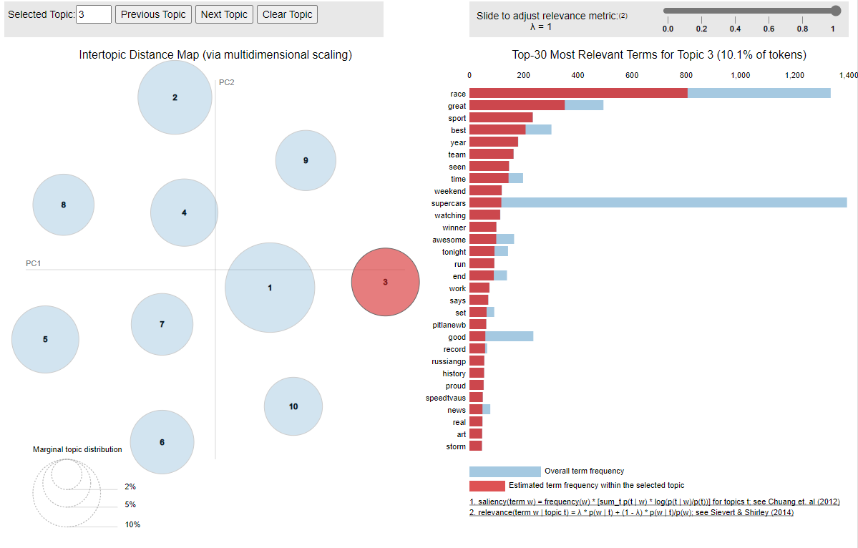

Slide 20
text | 1st largest topic
"what a final lap holy crap!!! #bathurst1000" | 0.819998975
"chaz mostert has all the chill. what a victory! #bathurst1000" | 0.819998934
"#v8sc #bathurst1000: #mostert/#morris win eight-hour bathurst thriller http://t.co/isnvp8zd8v" | 0.819998214
"ford 2 years in a row have conquered the mountain yayyyyyyy :) #v8sc" | 0.819996061
"whincup's conserving mostert desperate to get around, but can't t the top Ã‚Â #bathurst1000 #v8sc" | 0.819995908
"#v8sc mostert se lleva la bathurst 1000 sobrepasando a whincup en la ÃƒÂºltima vuelta" | 0.819995908
"wow that was unbelievable holy shit #bathurst1000" | 0.819994595
"rt @speedcafe: mostert and morris win bathurst #v8sc" | 0.81999442

Slide 21
text | 2nd largest topic
"this bathurst race has been an absolute belter!! love the aussie commentary. was hoping for better for my mate @jcourtney though #v8sc" | 0.827273192
"kiwis having terrible luck in #bathurst1000 at least #gigatownwanaka might have ufb" | 0.82
"ok #bathurst1000 is done and run i can focus on the end of this game" | 0.82
"rt @la_perdicion: mira @l3onardovzla tu no agarras a ninguna ... todas te odian... mientras q a estos mÃƒÂ¡s de una los ama @termic0 @rakety #Ã¢â‚¬Â¦" | 0.819999231
"some have their love of the great race proudly on display, for others it is art. http://t.co/5kshjiw8k1 #bathurst1000 #tatoos" | 0.819995542
"it's a race against the fuel tank. can he hold on? #bathurst1000 #v8sc" | 0.819993589
"#bathurst1000 massive race #fuelled by fuel. unreal. http://t.co/fwukgikr5g" | 0.819993589

Slide 22
Sentiment Analysis

Slide 23
Sentiment Analysis on Polarity
Systematically identify, extract and quantify affective states and subjective information
Simple polarity
Complicated polarity
Very positive
Positive
Neutral
Negative
Very negative
Positive
Negative
neutral

Slide 24
Sentiment Analysis
from nltk.sentiment.vader import SentimentIntensityAnalyzer
sentiment = SentimentIntensityAnalyzer()
sentiment.polarity_scores(tweet)
{'neg': 0.392, 'neu': 0.608, 'pos': 0.0, 'compound': -0.865}

Slide 25
Sentiment Analysis on Emotions and Aspects
Sentiment analysis on emotions, e.g., happiness, frustration, anger, sadness
Often use lexicons
Complex machine learning algorithms
Sentiment Analysis on Aspects
E.g., products reviews on price, quality, customer service

Slide 26
Measure Brand Personality and Experience via Machine-learning Based Sentiment Analysis
"Measuring Survey Scale via Machine Learning" @2019 Invention right/Patent, invented by Steven Lu (the chief investigator) in the University of Sydney Business School (US yd Ref. Number IP [#2018-11 OJ, NCHU Ref Number NCHU-108PX0001).
Published on European Journal of Marketing https://www.emerald.com/insight/content/doi/10.1108/EJM-01-2019-0084/full/html
Brand Personality

Slide 27
Measure Brand Experience via Machine-learning Based Text Analysis
Brand experience
Sensory/Affective | Behavioral | Intellectual
This brand makes a strong impression on my visual sense or other senses. I find this brand interesting in a sensory way. This brand does not appeal to my senses. This brand induces feelings and sentiments. I do not have strong emotions for this brand. This brand is an emotional brand. | I engage in physical actions and behaviors when I use this brand. This brand results in bodily experiences. This brand is not action oriented | I engage in a lot of thinking when I encounter this brand. This brand does not make me think

Slide 28
Measure Brand Personality and Experience via Machine-learning Based Sentiment Analysis
Procedure
Step 1: build a semantic dictionary
Step 2: collect data from Amazon Mturk
McDonald’s (315 participants) and Starbucks (309 participants)
200-word review and rating for each of brand personality dimensions
Step 3: sentiment analysis
Sentence level score first (-5 to +5)
Overall score
Step 4: using the actual rating to fine-tune conversion rate

Slide 29
What Can We Learn from Online Movie Reviews? Capturing Viewers’ Movie Experience through Machine Learning

Slide 30
Viewers’ Experience and Their Reviews Online
Positive sentiment :
cinematography, visuals, action scenes, cast, Jason Momoa
Negative sentiment :
dialogues cheesy & awkward, film scoring and soundtrack was a miss, villain character unidimensional.

Slide 31
State of Knowledge/ Focus of the study
Existing Studies
Focus of this study
Future Extension
Movie Reviews
Online platforms
Blog posts
Yahoo! Movies
Box Office Mojo
IMDB
Rotten Tomatoes
Volume
No. of reviews
Audience
Movie Experience
Box
Office Revenue
Overall
Movie Rating
Movie
Box Office Collection
Social Media
Twitter
YouTube
Current Challenges
How to measure movie experience from online reviews?
Our Solution in this study
Developing Movie Experience Scale
Develop movie experience scale based on existing research and questionnaire survey to measure multisensory, fantasy and emotive aspects of movie experience
Machine Learning
Extract textual data from movie reviews and use of scale-directed text analysis to reconstruct the movie experience
Other media sources
Baseline Inc.
Entertainment Data Incorporated(EDI)
Variety Magazine
TV Advertising
Valence
Rating& Pos/Neg Sentiments

Slide 32
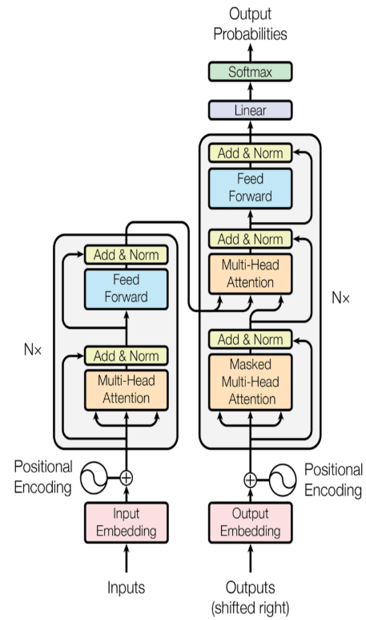


Methods
Each respondent writes a review
Provide ratings of each factor
Transformer model Architecture

Slide 33
Results
Factors
Dimensions
Factor1 Aesthetic
Factor2 Negative
Affective
Factor3 Positive
Factor4 Arousal
Factor5 Narrative Presence
Intellectual
Factor6 Nostalgia
Parasocial Relationship
Factor7 Parasocial Relationship
Factor8 Sensory Visual
Sensory
Factor9 Sensory Music

